Slide 1
Software Engineering BCA IV SEM
Introduction
Bijay Babu Regmi
bijay.regmi@deerwalk.edu.np

Slide 2
Definition of Software
More than a program code
Considered to be a collection of executable programming code, associated libraries and documentations
Also defined as a set of instructions, data or programs used to operate computers and execute specific tasks
On the other hand, engineering is all about developing products, using well-defined, scientific principles and methods
Types of Software:
System Software
Application Software

Slide 3
System Software
An intermediator or a middle layer between the user and the hardware
a software to manage computer hardware behavior so as to provide basic functionalities that are required by the user
These software allow an environment or platform for the other software to easily work in. Hence, it is the reason why the system software is quite important in the management of the entire computer system.
Few examples of system software are:
- Operating System
- Device Driver
- Firmware
- Utility

Slide 4
Continued….
Operating System
- a prominent example for system software
- a collection of software which handles resources as well as offers general services for various other application which actually run over them
- Example: Windows, macOS, Linux, Ubuntu, etc.
Device Driver
- type of software that controls particular hardware which is attached to the system
- hardware devices that need a driver to connect to a system include displays, sound cards, printers, mouse and hard disks
- Example: Printer drivers, ROM drivers, USB drivers, etc.

Slide 5
Continued….
Firmware
- a permanent software which is embedded in the system’s read-only memory
- a set of instructions which are permanently stored onto to the hardware device
- Example: BIOS, computer peripherals, embedded system, etc.
Utility
- designed to assist in analyzing, as well as optimizing, along with configuring and maintaining a given computer system
- provides support to the computer infrastructure
- Example: Norton Antivirus, WinRAR, WinZip, etc.

Slide 6
Application Software
also known as end-user programs or productivity programs are software that helps the user in completing tasks such as doing online research, jotting down notes, setting an alarm, designing graphics, keeping an account log, doing calculations or even playing games.
essentially lie above the system software
Few examples of application software:
- Word Processors
- Database Software
- Multimedia Software
- Web Browsers

Slide 7
Continued….
Word Processors
- Such applications are meant for documentation. It also assists in storing as well as formatting and even printing of the documents.
- Example: MS word, Google Docs, etc.
Database Software
- used to create as well as manage a database and also known as Database Management System
- assists in data organization
- Example: MS Access, MySQL, etc.
Multimedia Software
- software which is able to play, create as well as record images, audio or even video files
- Example: Adobe Photoshop, VLC Media Player, etc.

Slide 8
Continued….
Web Browsers
- utilized to browse the internet
- assist the users in locating as well as retrieving data well across the web
- Example: Google Chrome, Safari, etc.
Classification of Application Software:
- Free Ware: available without any cost i.e. Adobe Reader, Skype, etc
- Share Ware: freely distributed to users on a trial basis i.e. WinZip, Adobe Acrobat, etc.
- Open Source: available to users with the source code i.e. Apache Web Server, Mozilla Firefox, etc.
- Software: Closed-source software and usually paid and have intellectual property rights or patents over the source code

Slide 9
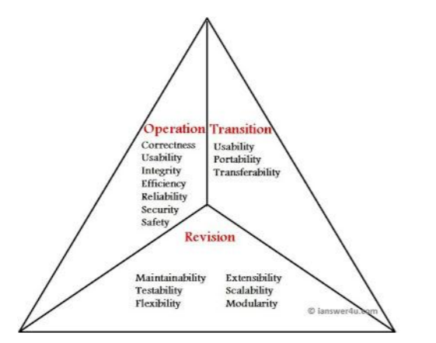
Characteristics of Software
Fig: Software quality triangle with characteristics

Slide 10
Operational Characteristics
functionality based factors and related to exterior quality of software
Types of Operational characteristics are:
Correctness: should meet all the specifications stated by the customer
Usability/Learnability: amount of efforts or time required to learn how to use the software should be less
Integrity: refers to the degree to which unauthorized access to the software data can be prevented
Reliability: set of attribute that bear on capability of software to maintain its level of performance under the given condition for a stated period of time
Efficiency: refers to the ability of the software to use System resources in the most effective and efficient manner.

Slide 11
Revision Characteristics
Related to interior quality of the software
Should be in-build in any good software
Types of Revision characteristics are:
Maintainability: maintenance of software should be easy for any kind of user
Flexibility: changes in the software should be easy to make
Extensibility: should be easy to increase the functions performed by it
Scalability: should be easy to upgrade it for more work (or for more no of users)
Testability: testing the software should be easy

Slide 12
Transition Characteristics
Interoperability: ability to exchange information with other applications and make use of information transparently
Reusability: should be reusable or modifiable
Portability: should be able to perform same functions across all environments and platforms

Slide 13
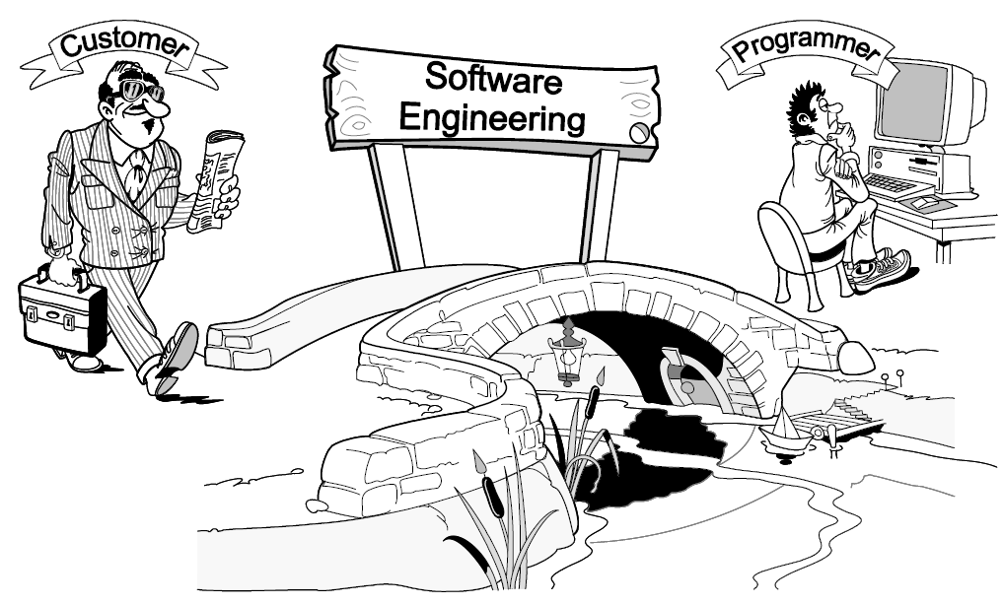
Software Engineering
is the creative activity of understanding the business problem, coming up with an idea for solution, and designing the “blueprints” of the solution
programming is the craft of implementing the given blueprints
purpose of software engineering is to develop software-based systems that let customers achieve business goals

Slide 14
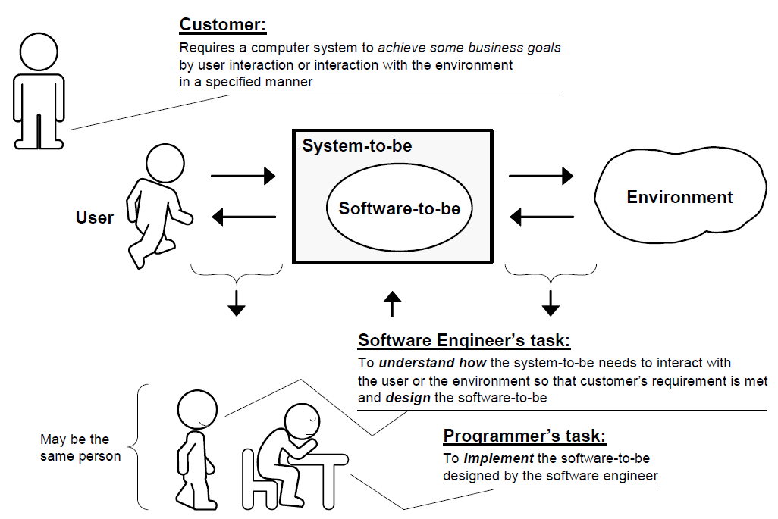
Continued…
Fig: Role of Software Engineering

Slide 15
Software Engineering Costs
is typically concerned with the financial spend on the effort to develop and test the software, this can also include requirements review, maintenance, training, managing and buying extra equipment, servers and software
Methods to estimate cost in Software Engineering:
- Analysis Effort Method
- PERT
- UCP
- COCOMO

Slide 16
Key Challenges
Understanding large and complex system requirements is difficult
- include those requirements which are unclear and difficult to understand
Undefined system boundaries
- no defined set of implementation requirements
Customers are not clear about their needs
- unsure about the exhaustive list of functionalities they wish to see in the software
Conflicting requirements
- two different stakeholders or even a single stakeholder express demands which contradict each other’s implementation
Changing requirements
- after a successive review from a customer, there is possibility that the customer express a change in initial set of special requirements.

Slide 17
Continued….
Identifying critical requirements
- Identifying the set of requirements which have to be implemented at any cost is very important
Proper documentation, proper meeting time and budget constraints
- Ensuring a proper documentation is an inherent challenge, especially in case of changing requirements. The time and budget constraints too need to be handled carefully and systematically.

Slide 18
System and Software Engineering
Systems engineering is thinking of the system as a whole, including the software, hardware, servers needed to host the software, materials used for construction of the parts etc.
In system engineering, you tend to work with lower level software and hardware to solve problems.
System Engineers focus more on users and domains
Software engineering is a discipline whereby you solve problems using computers as a tool; this contrasts with programming, where you turn problem solutions into machine instructions, but you do not necessarily understand those solutions yourself.
in software engineering you tend to work with software of medium/ higher levels and typically won't do as much with hardware.
Software Engineer focus more on implementing quality software.

Slide 19
Professional Practice
concerned with the knowledge, skills and attitudes that software engineers must possess to practice software engineering in a professional, responsible and ethical manner
The term “professional practice” refers to a way of conducting services so as to achieve certain standards or criteria in both the process of performing a service and the end product resulting from the service.
A software engineer maintains a professional practice by performing all work in accordance with generally accepted practices, standards, and guidelines notably set forth by the applicable professional society.
For example, the Association for Computing Machinery (ACM) and IEEE Computer Society (IEEE CS) have established a Software Engineering Code of Ethics and Professional Practice.

